Slide 1
Persistent identifiers and research
& why you should care...
Siobhann McCafferty
ARDC
siobhann.mccafferty@ardc.edu.au

Slide 2

Notes:
[ask audience] What is an identifier? What are examples of identifiers?
Answer:
An identifier is - a label that is applied to a person, an object or a class of objects.
Examples of identifiers are personal names, tax file numbers, credit card numbers etc.
An identifier can be made up of numbers, letters, symbols or a combination of these. They provide a means of naming a person, object or a class of objects so that someone who reads or sees the identifier can work out what it refers to.
[ask audience] Is it possible to have two identifiers that are exactly the same?

Slide 3
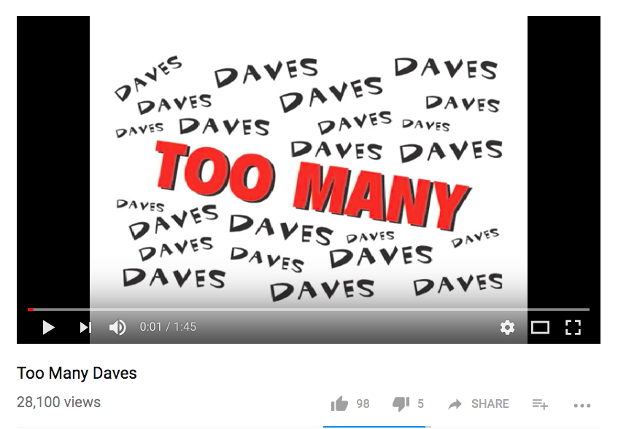
Notes:
Answer: yes, for example personal names - refer to the Dr Seuss poem “too many Dave’s” (with apologies to any Dave in the room!)
(Show clip)
So we have a problem: names as identifiers are not unique.
In fact, even if Dave’s mum had named one of her sons “Oliver Bolliver Butt”, there may well be someone else out there with that same name.

Slide 4

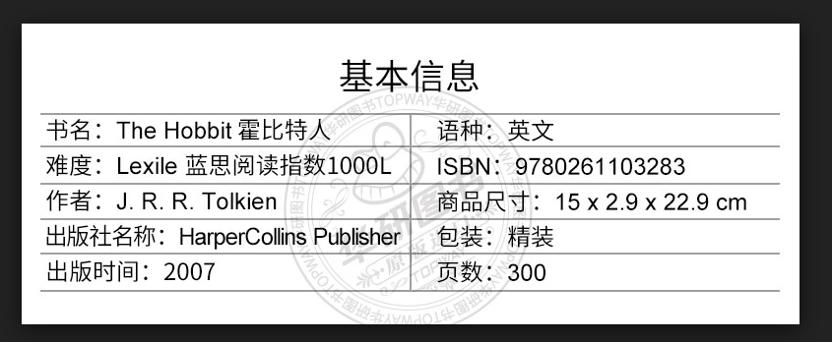

Notes:
Because of this problem, identifiers rather than names should be used and they need to be unique. For example, the International Standard Book Number or ISBN is assigned to identify a class of objects called books. ISBNs are a unique numeric identifier assigned to books and book-like products and are used primarily to facilitate the international book trade and the library market.
In this example you can see the ISBN for ‘The Hobbit’. It can be used regardless of the language used to describe the book itself and therefore you can use that number with confidence to search for that book across multiple databases and the web as a whole. Sometimes the ISBN is expressed as a barcode, often printed on the book itself, as this example shows.
No other book has the same ISBN. This uniqueness is assured by the identity management structure whereby an ISBN Registration Agency controls the issuing of identifiers to these books.
So in this example, there is a class of identifiers called ISBN’s, they are used exclusively for books, they are controlled by a Registration Agency for these identifiers, and this ensures the numbers are unique and authoritative.

Slide 5
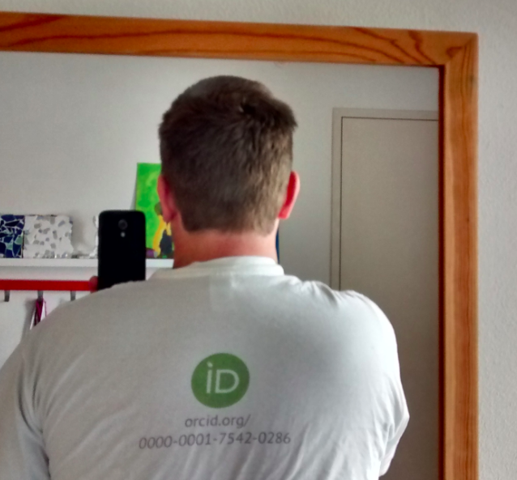
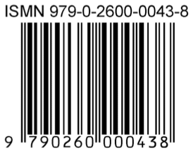


Notes:
[ask audience] What other identifiers can you think of in the scholarly world?
Answer: Some examples include: ISSN for periodicals; ISMN for printed music; LCCN for Library of Congress cataloguing records; DOIs for publications and data; ISNI, ResearcherID, ScopusID and ORCID for researchers.
Identifiers can be applied to both offline and online objects. For example, the IGSN is an online identifier for physical samples. The IGSN points to a metadata page which describes the sample and gives information such as the location where the physical sample is held.

Slide 6
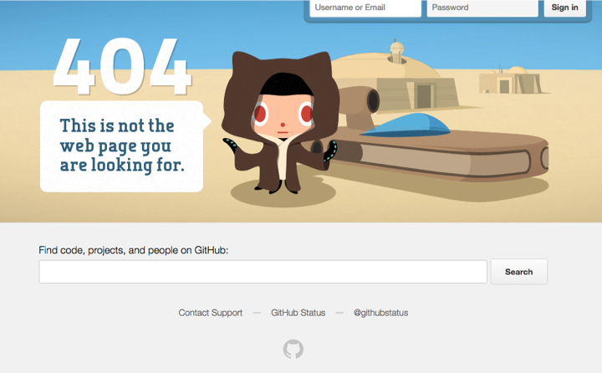
Notes:
[ask audience] The problem with web identifiers - URLs - is this. What has happened to cause this error message?
Answer: generally caused when the resources are not maintained at the referenced URLs. For example, the URL has changed but the old version of the URL is the one you clicked and there is no automatic forward in place to take you to the new URL.
In research, the 404 type errors are a real problem. The error means that a resource - like a journal article - that may have been cited in a scholarly publication using its URL may no longer be accessed. This is frustrating for those who want to read the citation and also for those who want to confirm the claims made in the paper based on the citation.
A persistent identifier addresses this problem because it is an identifier that is guaranteed to be maintained over time in an online environment. A persistent identifier - or PID - should always resolve to an online page that contains information about the object it represents. This is the case whether the object has been moved to another location or even removed completely. The result is that resources with persistent identifiers can be cited with far more confidence than those which do not.

Slide 7

Notes:
[ask audience] Whose responsibility do you think it is to maintain a PID?
Answer: there are multiple levels of responsibility depending on the PID system. Usually:
The PID Registration Agency or governing body - for maintaining the PID system
The organisation who minted the PID through the RA to maintain the identifier i.e. make sure it resolves to a landing page (even if the resource moves0
May also be up to the researchers whose works are identified by the PID e.g. notify their institution if the resource has been withdrawn or moved, update their own record such as ORCID

Slide 8


Notes:
Let’s now look closer at a specific identifier: Digital Object Identifiers or DOIs.
[ask audience] Who can tell me what a DOI is?

Slide 9
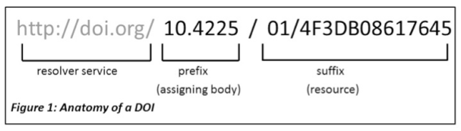
Notes:
Answer: A DOI is a globally unique, alphanumeric string or name that identifies digital content on the web [show example].
It consists of a prefix and a suffix separated with a forward slash. A DOI prefix always begins with the number 10 and this distinguishes it from other implementations of the Handle System, of which DOIs are one implementation. The rest of the numbers in the DOI string refer to the registrant code and the item identifier.

Slide 10

Notes:
DOIs can be expressed as a number or in a web resolvable form.

Slide 11
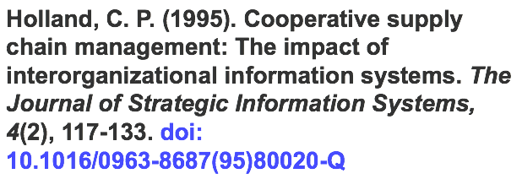
Notes:
DOIs are quoted in citations as this APA style example shows
DOIs evolved from the publishing industry to persistently identify online content, specifically scholarly journal articles.
DOIs are an international standard (ISO 26324) and they are distinguished from other PIDs in two aspects:
● The system is governed by the International DOI Foundation and the minting ( which is another word for issuing) of DOIs can only be done by a DOI Registration Agency;
● A minimal amount of metadata is required to mint a DOI like author, title, publisher, date and URL

Slide 12
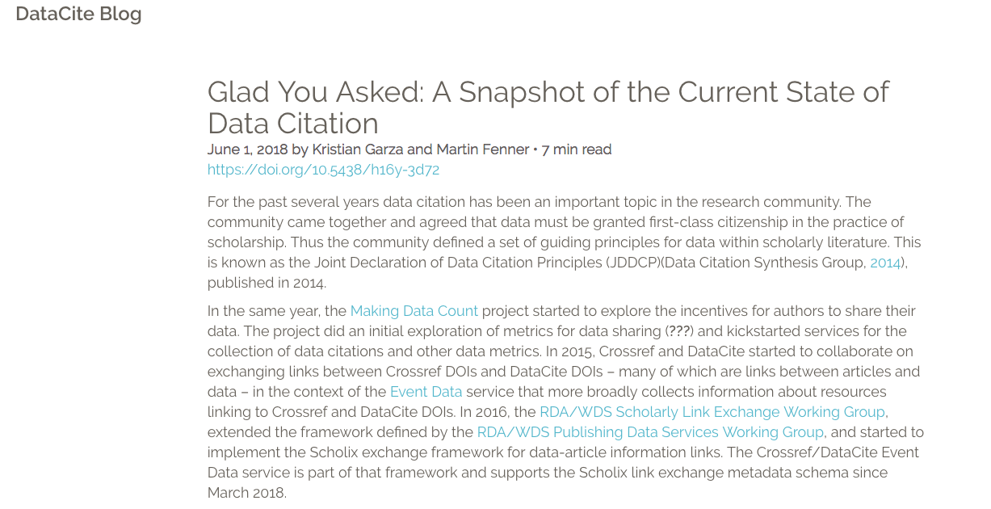
Notes:
[ask audience] I mentioned that DOIs are routinely assigned to scholarly publications, what else can they be the assigned to?
Answer: a wide range of scholarly publications and research objects including journal articles and book chapters; research datasets, software; and grey literature like conference papers, theses and reports, videos, physical samples, events and yes, blog posts (as this example shows).
DOIs are issued by a publisher - for example, when a journal article is published - and by repositories - for example when a dataset is published to a repository.

Slide 13
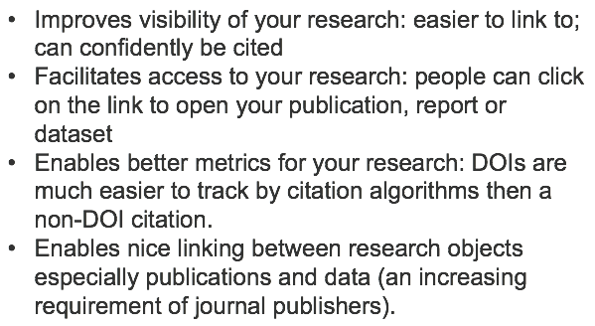
Why oh why should I use a DOI?
Notes:
How do you think DOIs could help you as a researcher?
Answer:
● Improves visibility of your research: easier to link to; can confidently be cited
● Facilitates access to your research: people can click on the link to open your publication, report or dataset
● Enables better metrics for your research: DOIs are much easier to track by citation algorithms then a non-DOI citation.
● Enables nice linking between research objects especially publications and data (an increasing requirement of journal publishers [show example from Nature and PLOS]) and also research (DOIs) and the researchers who publish the research (ORCIDs).

Slide 14
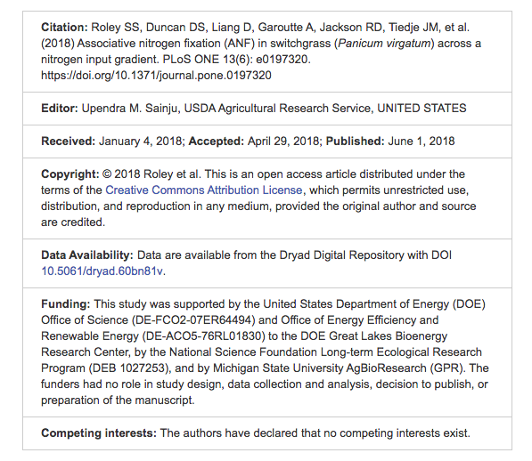
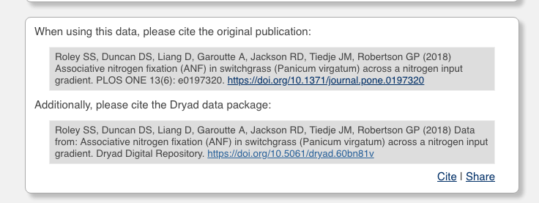
https://doi.org/10.5061/dryad.60bn81v
Notes:
How a DOI redirects to a landing page + scholarly publication with DOI that links to data via data DOI

Slide 15


Notes:
I mentioned that DOIs are only issued by DOI Registration Agencies.
For publications, the DOI RA is CrossRef and for datasets and grey literature the DOI RA is DataCite.
Universities and other research institutions become members of the RA or it’s agency and begin minting DOIs for research objects that are held in their institutions. Repositories do the same.
Publishers also routinely issue DOIs for journal articles as a standard part of the manuscript publication process. So to get a DOI you need to either get one from your publisher or your institution (library or IT usually) or the repository to which you deposit your dataset or other scholarly material. In Australia, ANDS acts as a registration agency for DataCite and institutions can use the service to mint DOIs at no charge for research data, software and grey literature as per the DataCite DOI guidelines.

Slide 16

Find information about this DOI:
10.4225/08/5858219e78f9a
What type of research output does this DOI point to?
What is the organisation associated with this DOI?
Can you get to the full text from the DOI?
Now search for the same DOI in DataCite search: https://search.datacite.org/
How do you cite it in Vancouver style?
Who issued the DOI?
Finally, go to DataCite stats: https://stats.datacite.org/
For the Australian National Data Service, which organisation minted the most DOIs for 2018?
Photo by Amaury Salas on Unsplash
Notes:
Time to get your hands dirty with DOIs!
Have a go at this exercise…..
\

Slide 17

Photo by Tyler Nix on Unsplash
Notes:
We’ve looked at persistent identifiers - what they are, how they are used in research, plus we’ve examined DOIs and why you might want DOIs to be assigned to your research.
In this next section, we’re going to look at PIDs for people, specifically, for researchers.
[ask audience] What do you think is the most common surname in Sydney?

Slide 18
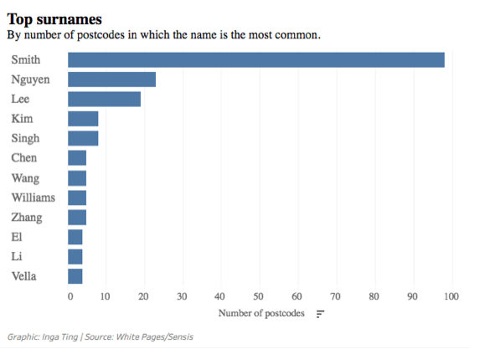
Notes:
Answer: Smith, but strong trend toward Nguyen. Hundreds of thousands of Australians have the same surname.

Slide 19
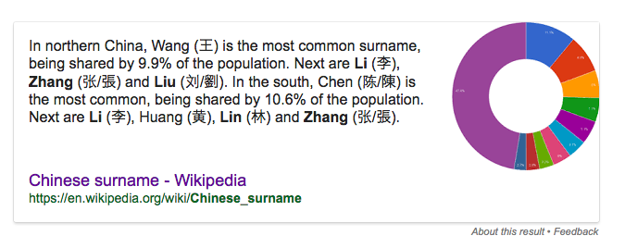
Notes:
Common names are a real problem, especially in the scholarly world and particularly in China

Slide 20


Notes:
Other name problems include: names changes (divorce, marriage, deedpoll), name variations in scholarly literature (David Wright, D Wight, DA Wright) and misspellings (D Right). These problems can have a big impact on research: mainly, that the wrong person is attributed to the research.
How do we fix this problem? The answer is in assigning persistent identifier for people, specifically ORCID

Slide 21
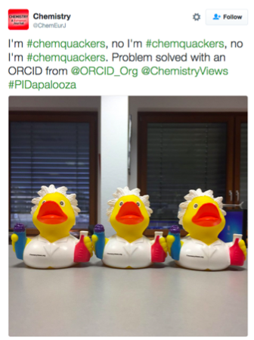

Notes:
ORCID stands for Open Researcher and Contributor Identifier. It is a unique, persistent identifier assigned to researchers to disambiguate one researcher from another. It groups all of your works under one online, resolvable web identifier ensuring you get correct attribution and credit for research
[ask audience] Who has heard of ORCID? Who has an ORCID?
Shortly we will be creating or updating ORCID records. But first, a little more background.

Slide 22
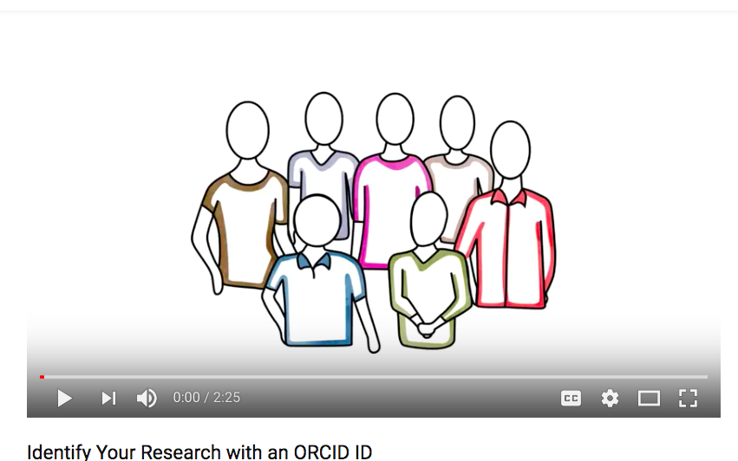
https://www.youtube.com/watch?v=7MxEAMIhawg

Slide 23

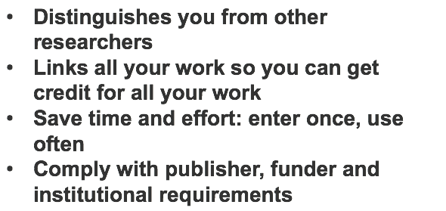

Slide 24
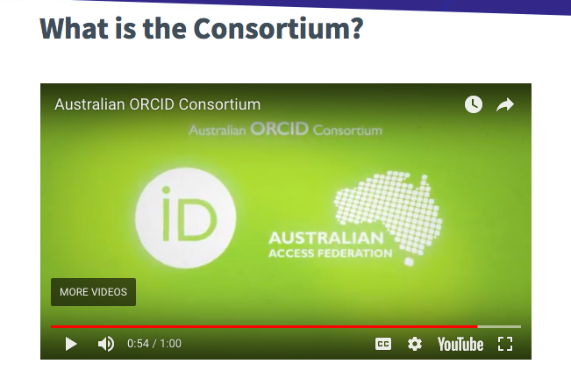


https://aaf.edu.au/orcid/
Notes:
ORCID is free to join for researchers who simply sign up online. It only takes a few moments. Institutions can join ORCID for a small fee which enables them to interact with ORCID at a technical level (using the API).
In Australia, we have an ORCID consortium of 40 institutional members including 36 universities, CSIRO, the Heart Foundation and our two major funders, ARC and NHMRC. The Consortium follows the release of a Joint Statement of Principle in support of ORCID that has been signed by various key players in Australian research. Our funders are looking to integrate ORCID into their systems [show] - in fact the ARC will ask you for one now - and in the future, this will save you time on funding applications. For example, NIH uses your ORCID iD to pull your works into your funding application and select the 5 most relevant ones for that application.
Funders will also - with your permission - be able to write to your ORCID records and asset that you have been awarded that grant.
Similarly, for publications, you’ll be asked for an ORCID at manuscript submission and the publisher - with your permission - will write to your ORCID record to show you have published that material. Same with datasets and other research outputs. This will save you time as your institution will be able to get this information by reading your ORCID record rather than asking you to manually input it into their systems. And if you change institutions, they can also simply read your ORCID record to get your publications history.
ORCID is about researcher control. With ORCID, you control what you put in your ORCID, who sees what information and who can update it.

Slide 25
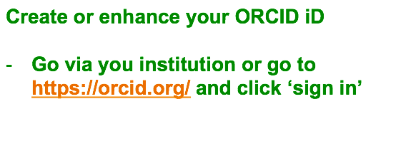

Slide 26
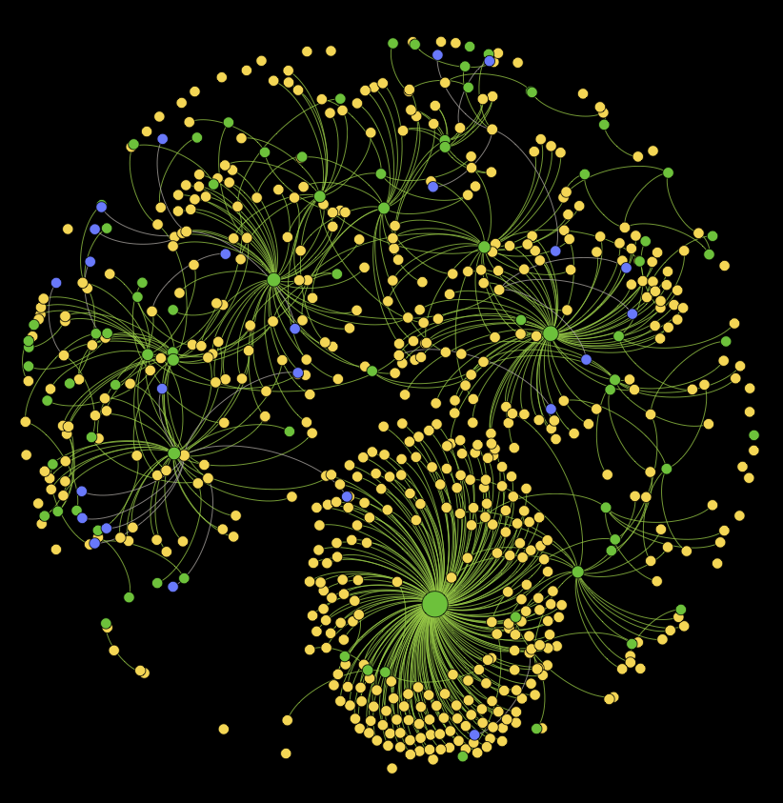

Notes:
Now that we have looked at two PIDs it is useful to see just how they work to support connected research. One such way is via initiatives such as Research Graph.
Research Graph is an open collaborative effort geared to connect scholarly records across global research repositories and is able to visualise a global network of research connections.
This network links research objects (publications, dataset, researcher profiles and grants) from
Research Infrastructures such as ORCID, DataCite, Crossref, Research Data Australia,
Open Access Repositories such as Dryad, figshare, NCI,
Funders including National Institutes of Health (NIH), Australian Research Council (ARC), and more.

Slide 27

Notes:
Here for example we can have a look at the Research graph for NCI here in Australia.
http://researchgraph.org/wp-content/uploads/nci.html
Feel free to open up the interactive graph and investigate the various points and their links.

Slide 28

Photo by Cristian Escobar on Unsplash
Notes:
In this session we have looked at persistent identifiers and how they benefit the discovery and linking of research and researchers.
I hope you have learned a lot and that it’s lit a spark inside of you that will help you enhance your research discovery and impact.
Please feel free to follow up with myself or Ginny on any questions you have following this session. Thank you.

Slide 29
Level 2, AIBN (Building 75) Brisbane QLD 4072 AUSTRALIA
+61 405 340 986 siobhann.mccafferty@ardc.edu.au ardc.edu.au

